Slide 1
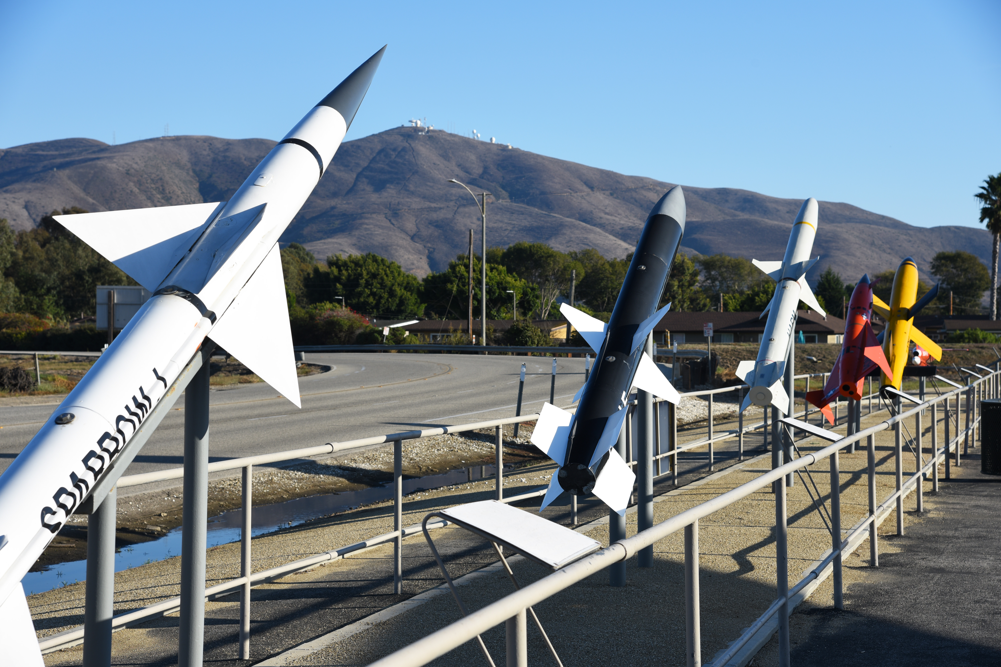
Articulating Nose Cone
Jed Fazler | Noah Moffeit | Nicholas Samuda | Robert Smith
Notes:
https://visualhunt.com/f7/photo/32891036558/2ed24545c0/

Slide 2
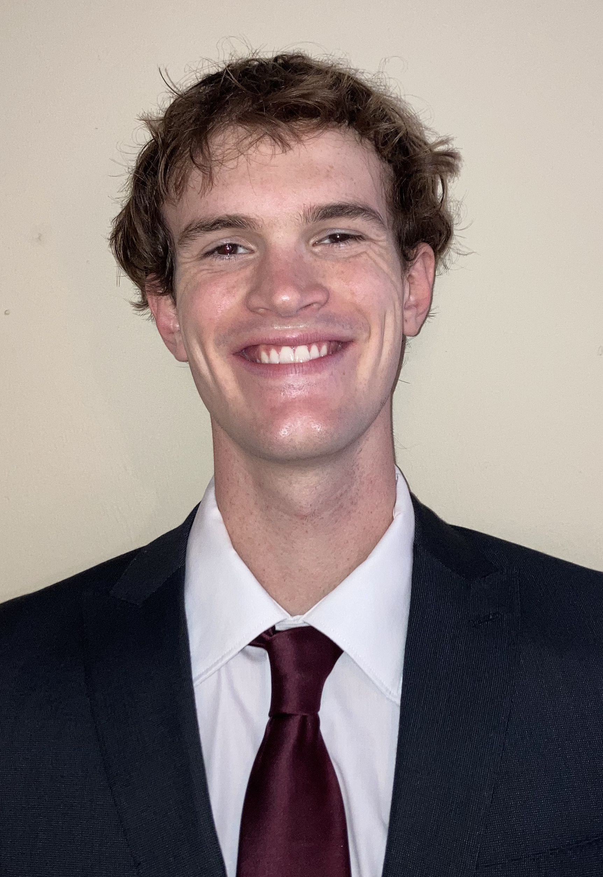
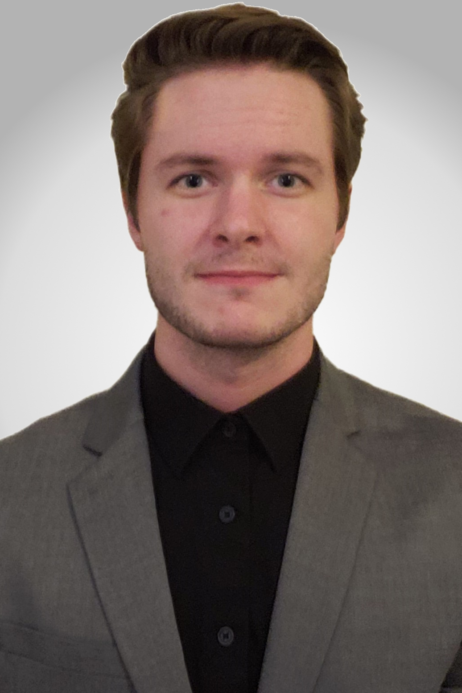
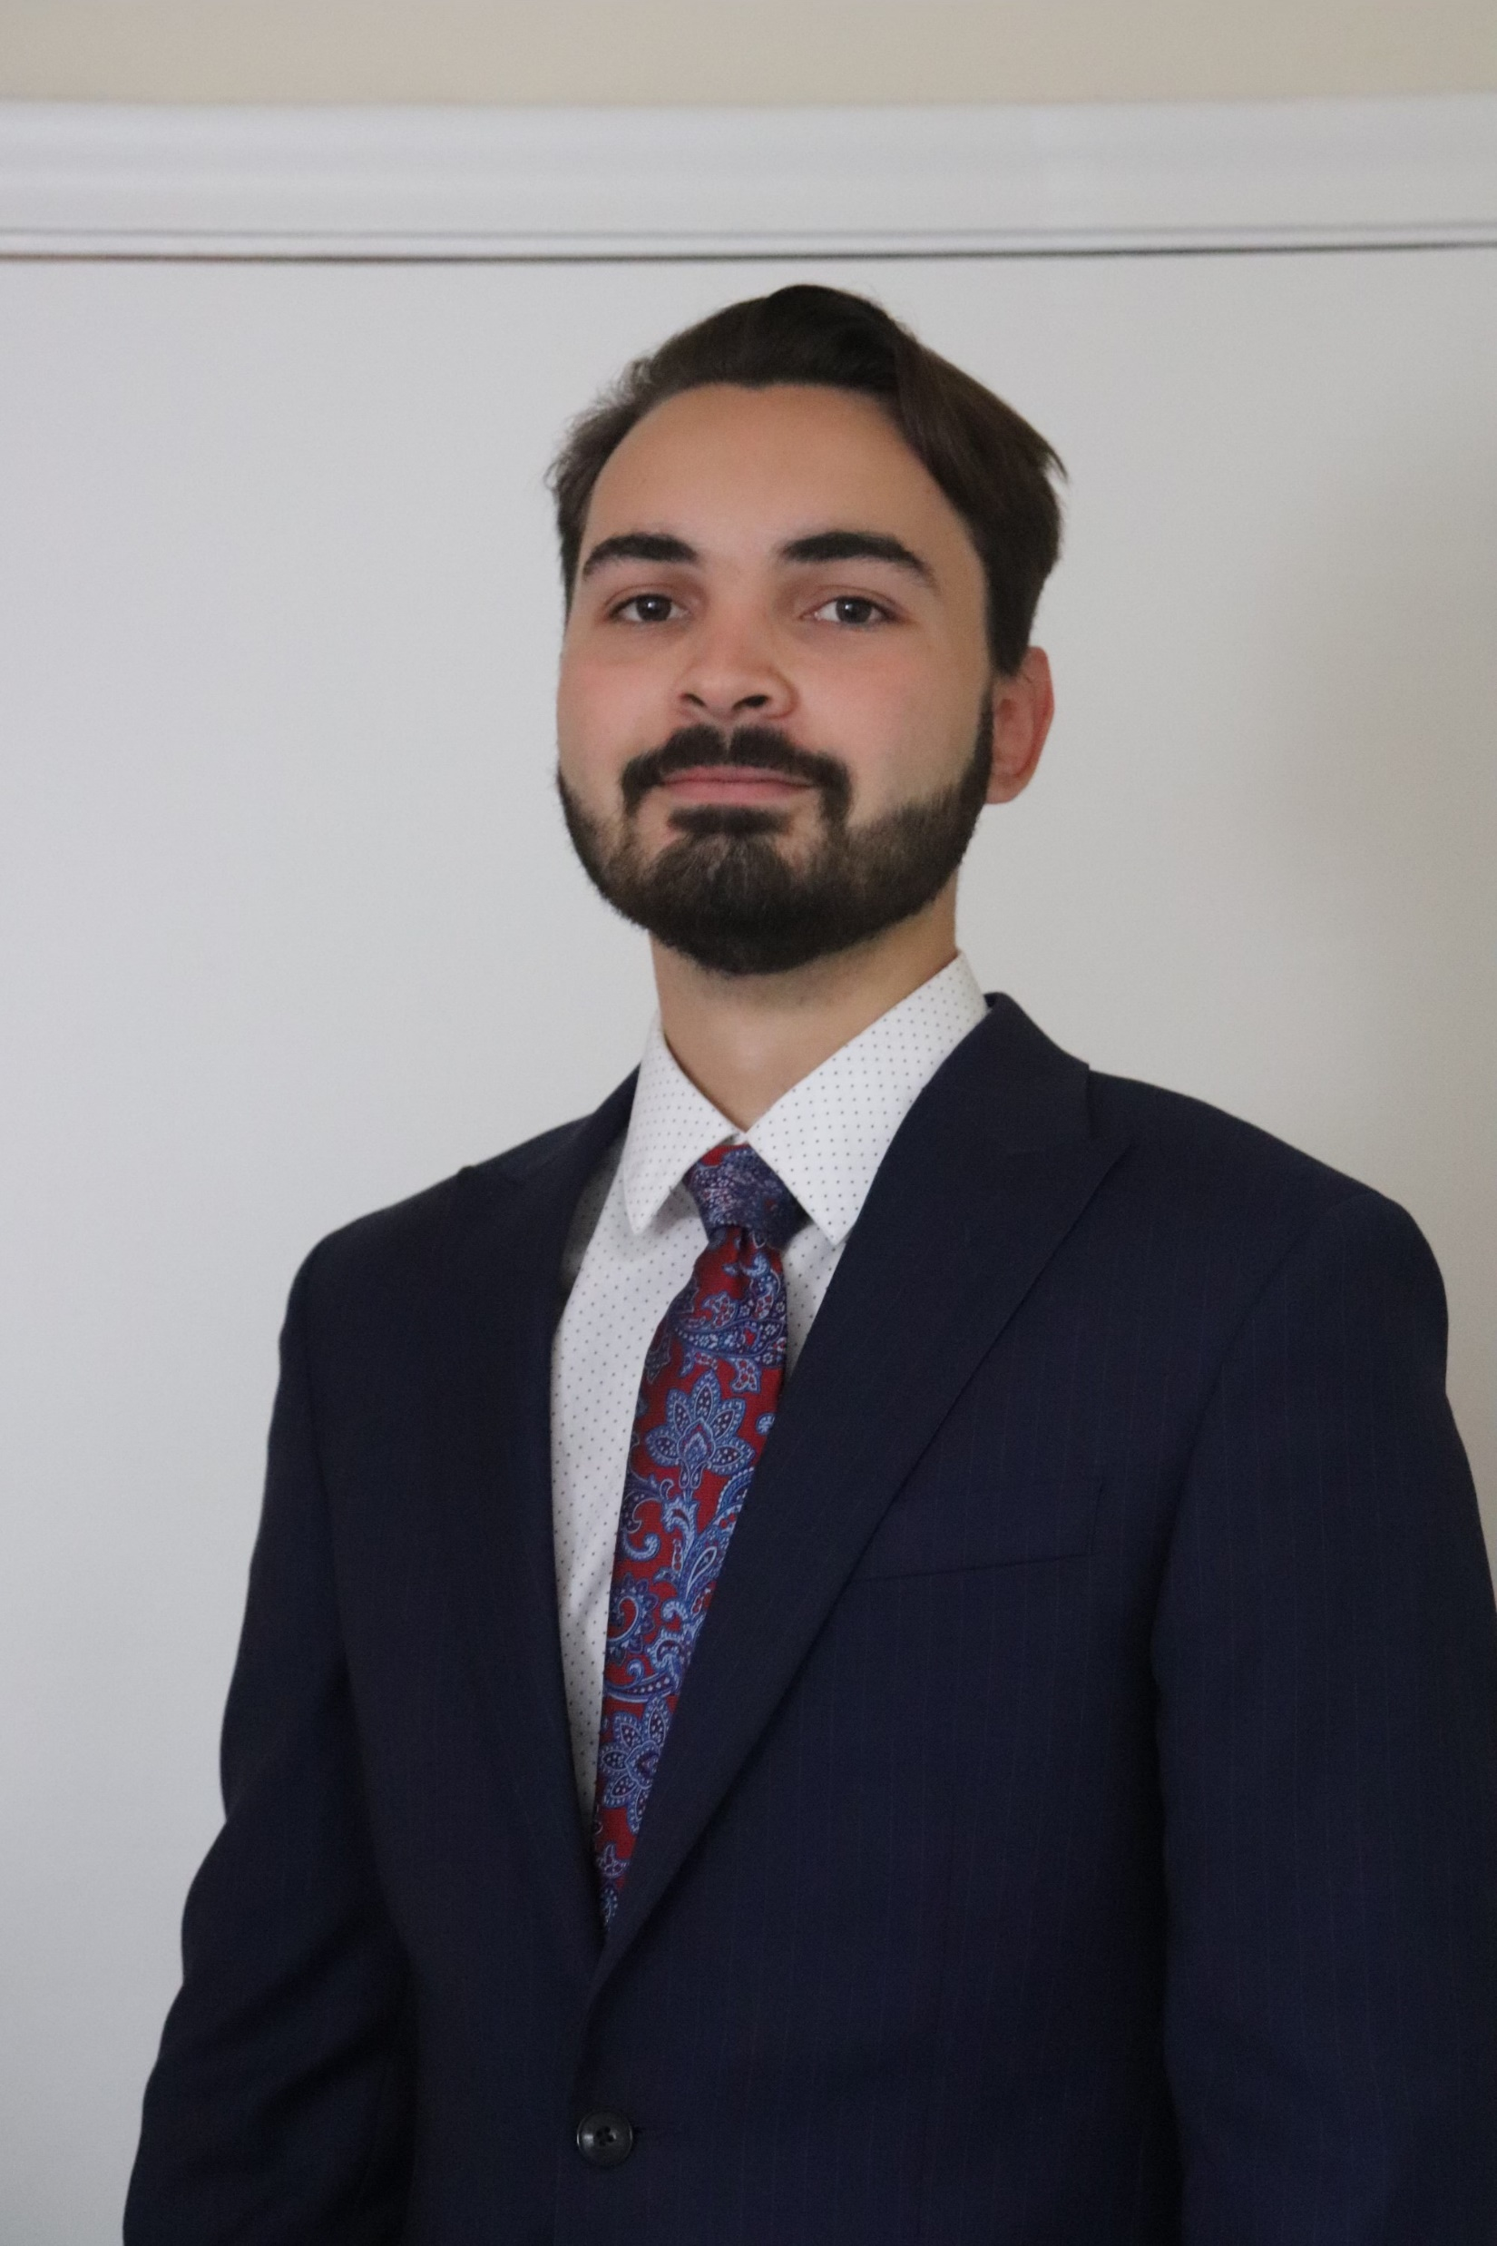
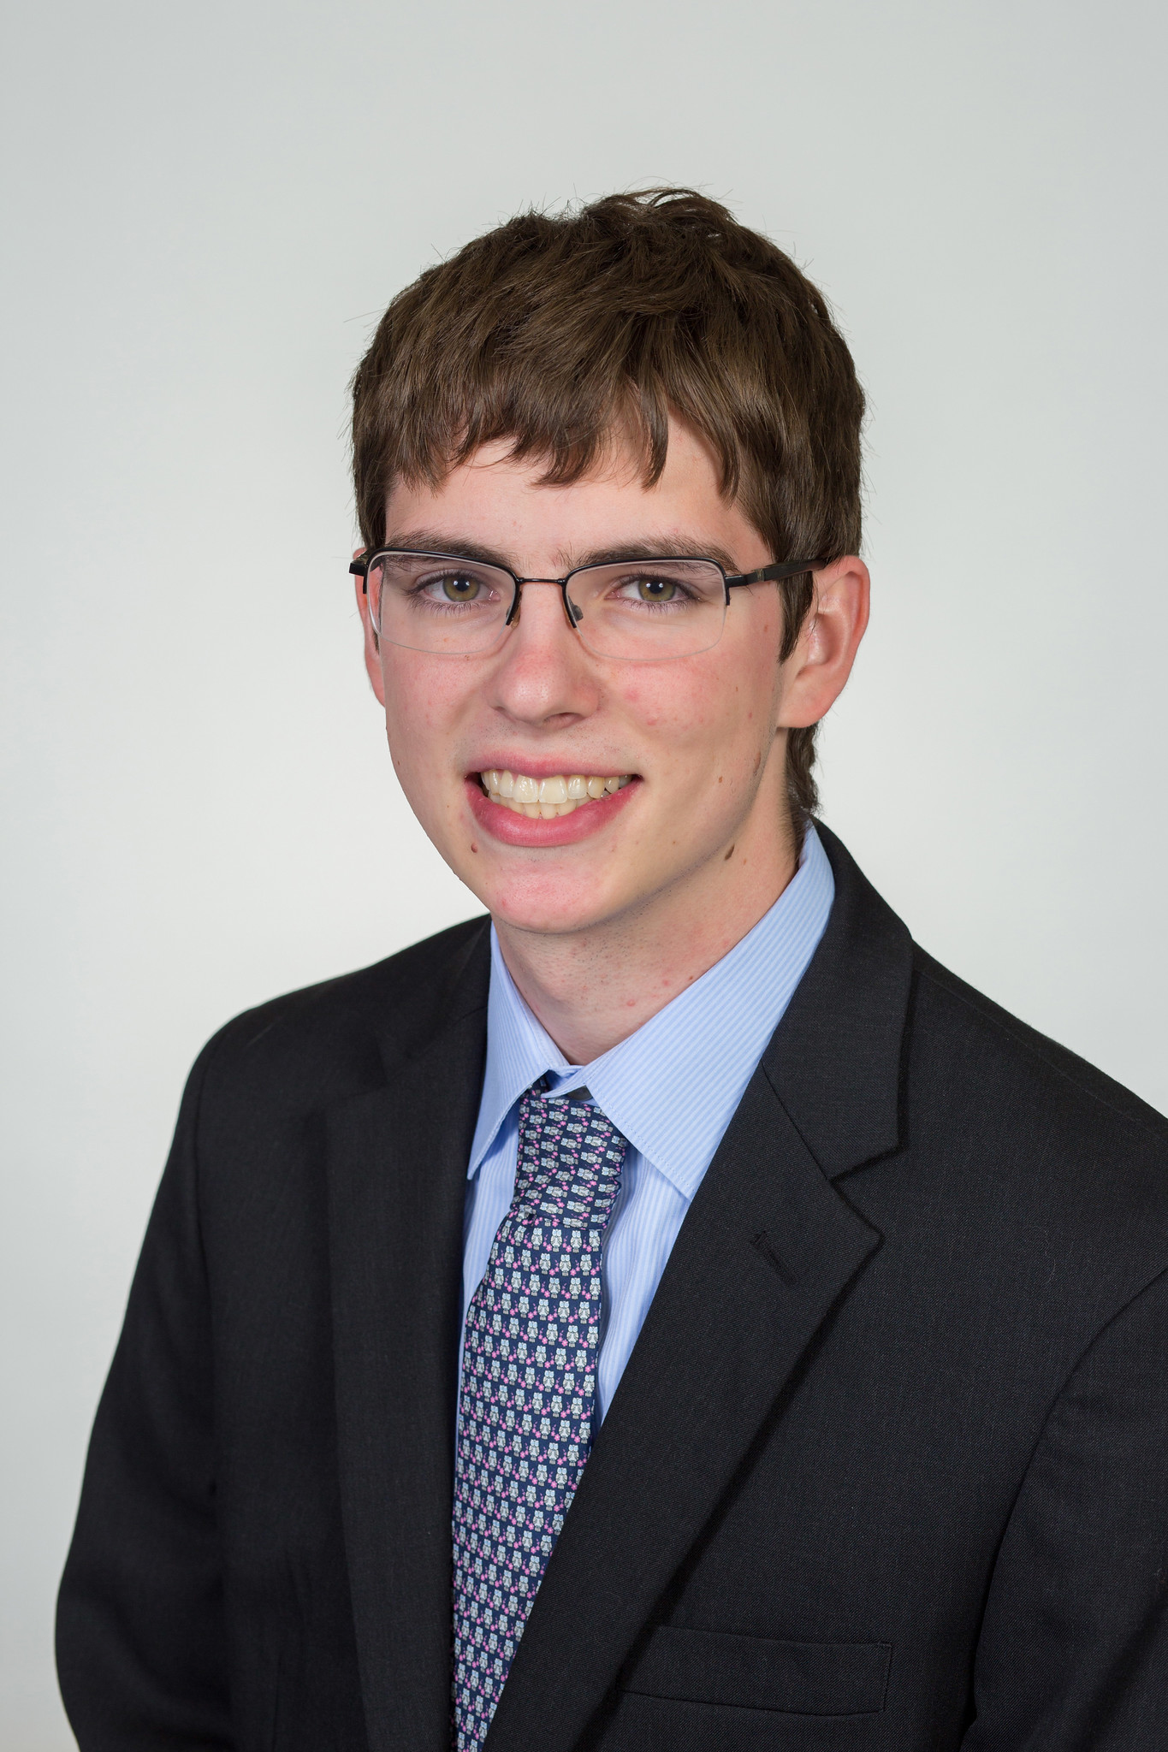
Team 504 Introductions
Jed Fazler
Field Engineer
Noah Moffeit
Test Engineer
Nicholas Samuda
Systems Engineer
Robert Smith
Research Engineer
Nicholas Samuda

Slide 3
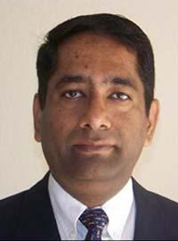
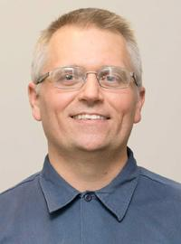

Sponsor and Advisor
Dr. Rajan Kumar
Dr. Jonas Gustavsson
Nicholas Samuda
Notes:
Our project sponsor is Dr. Rajan Kumar, he is an Associate Professor at the FAMU-FSU college of engineering and the Director of the Florida Center for Advanced Aero-Propulsion. Our project advisor is Dr. Jonas Gustavsson who works as an Associate Scientist at FCAAP.

Slide 4
Project Scope
Design the method of articulation for a nose cone during testing in a low-speed wind tunnel while keeping a smooth edge transition.
Nicholas Samuda

Slide 5

Project Considerations
Tunnel Testing
Real World Use
Importance placed on the applicability of the design at larger scales
Nicholas Samuda

Slide 6
Critical Targets and Metrics
Articulate the nose cone to obtain a pitch and yaw of ± 20°
Keep transition edges smooth between nose and body
θ
Nicholas Samuda

Slide 7

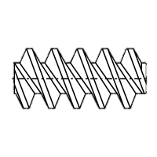


Concept Generation
Nose Pulleys
Linear Actuators
Rotating Contact Surfaces
2 DOF Gear Box
Polar Controller
Basic Rotating Nose
Nicholas Samuda

Slide 8
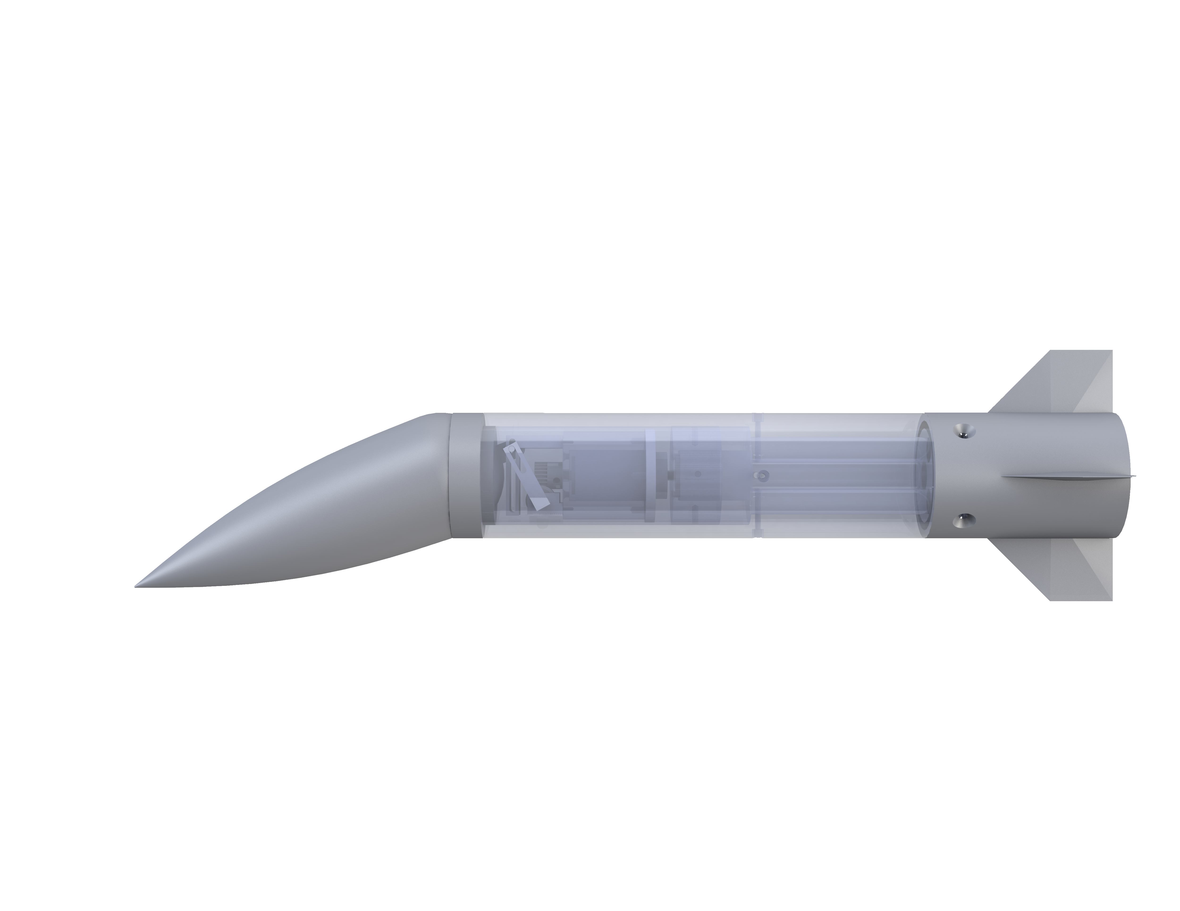
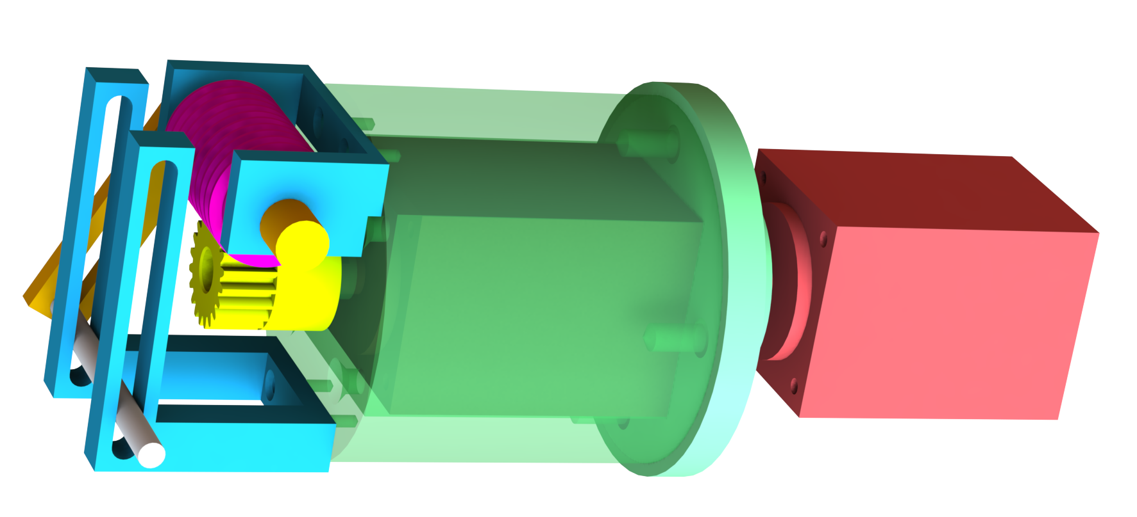
Preliminary Design: Polar Control
4
1
6
4
1
Pin Holders
Worm Gear
3
2
5
Spur Gear
Sliding Pin
3
Pin Slot Link
6
Motor Mount
5
2
7
7
Stepper Motor
Nicholas Samuda

Slide 9
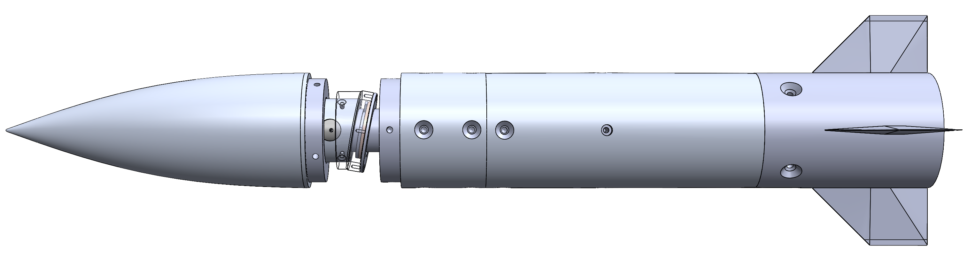
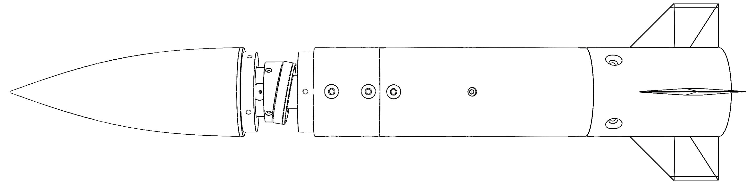
Selected Design: Concentric Surfaces
Implements the use of two angled surfaces for articulation
- Uses two stepper motors for rotation and deflection
- Requires a universal joint at the concentric surfaces
Nicholas Samuda

Slide 10
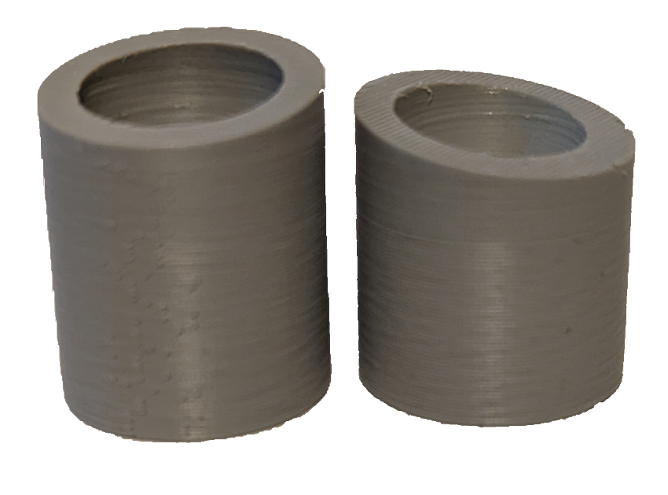
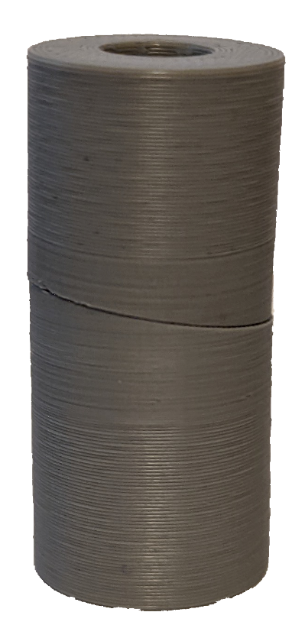
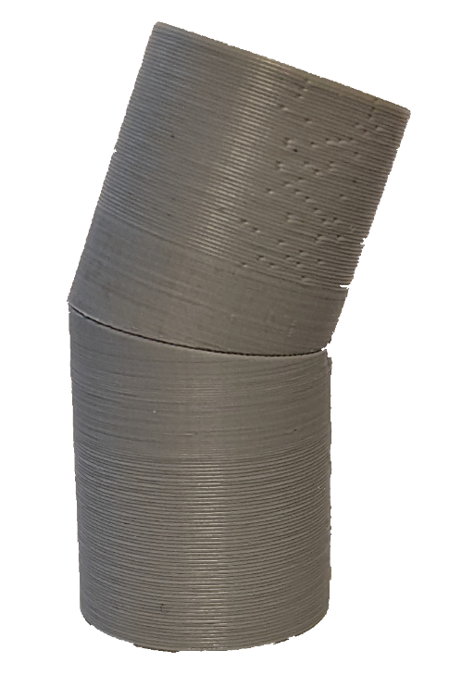

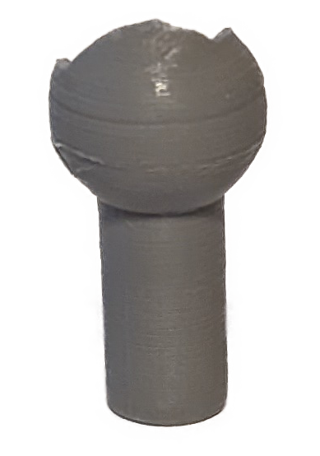
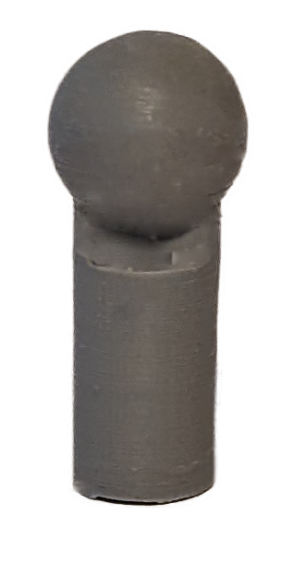

3D Printing and Prototyping
20° of rotation achieved
10° concentric surfaces
Universal joint
Ball and socket pins
Noah Moffeit

Slide 11
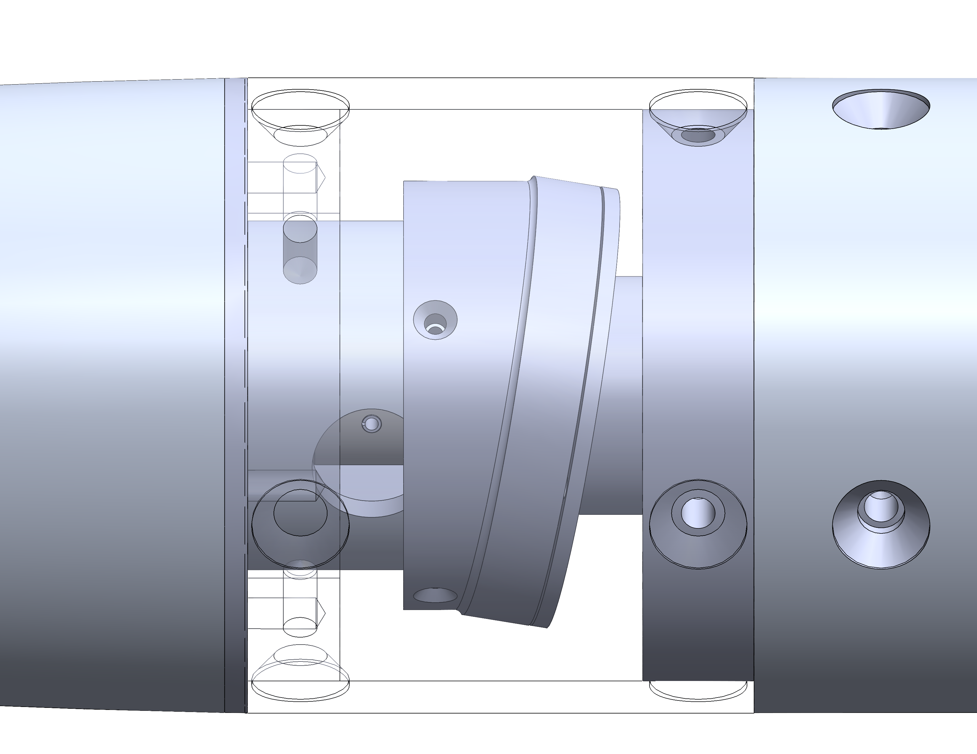
Gap Handling
Gap
- Investigate flexible materials for the nose to body interface
- Gap could possibly cause issues with stability of flow
- Attempted Solutions:
  Silicon
  3-D Printed TPU Filament
  Multi-Filament 3-D print
Noah Moffeit

Slide 12
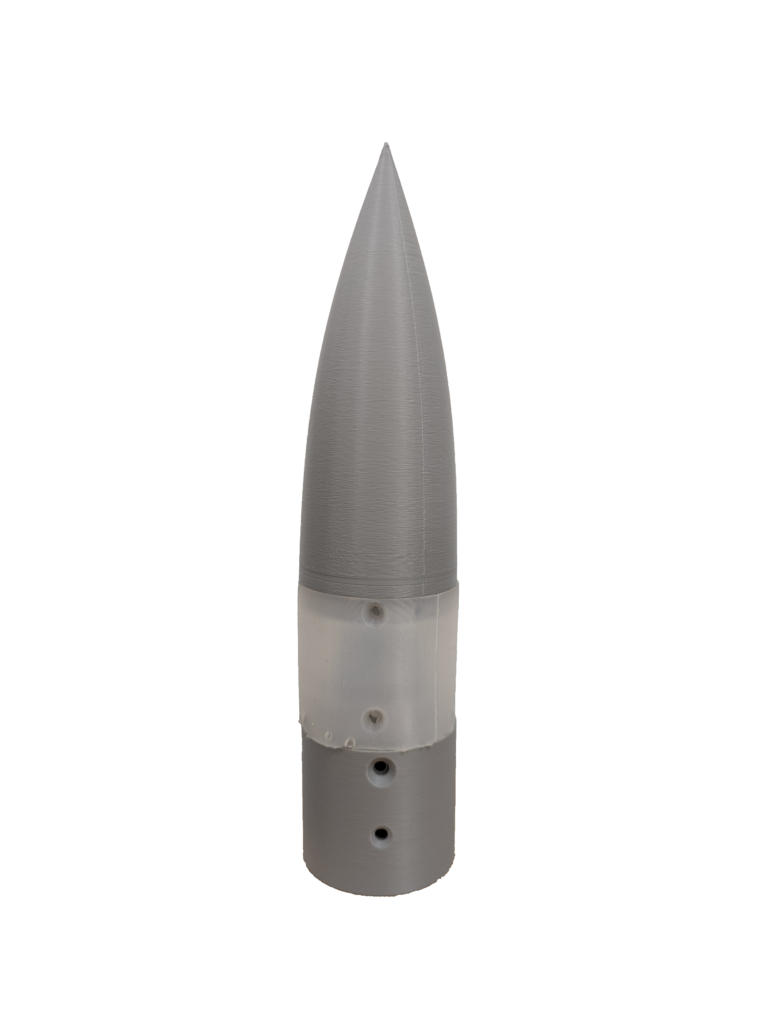
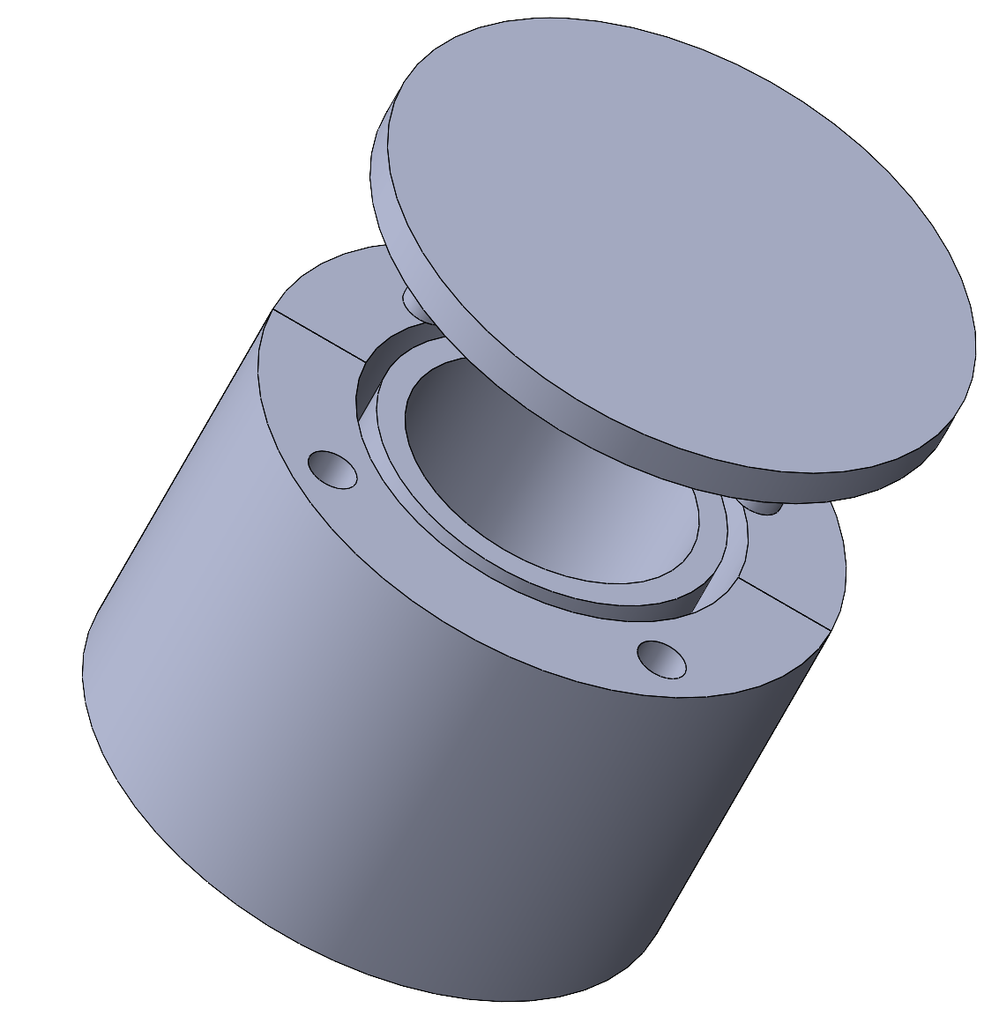
Gap Handling: Cast Resin
A silicon resin was cast in a 3D printed mold
  High flexibility that allows for bending
  Bubbles developed inside the resin creating possible stress concentrations
  Pinching occurs at moderate to high deflection
Noah Moffeit

Slide 13
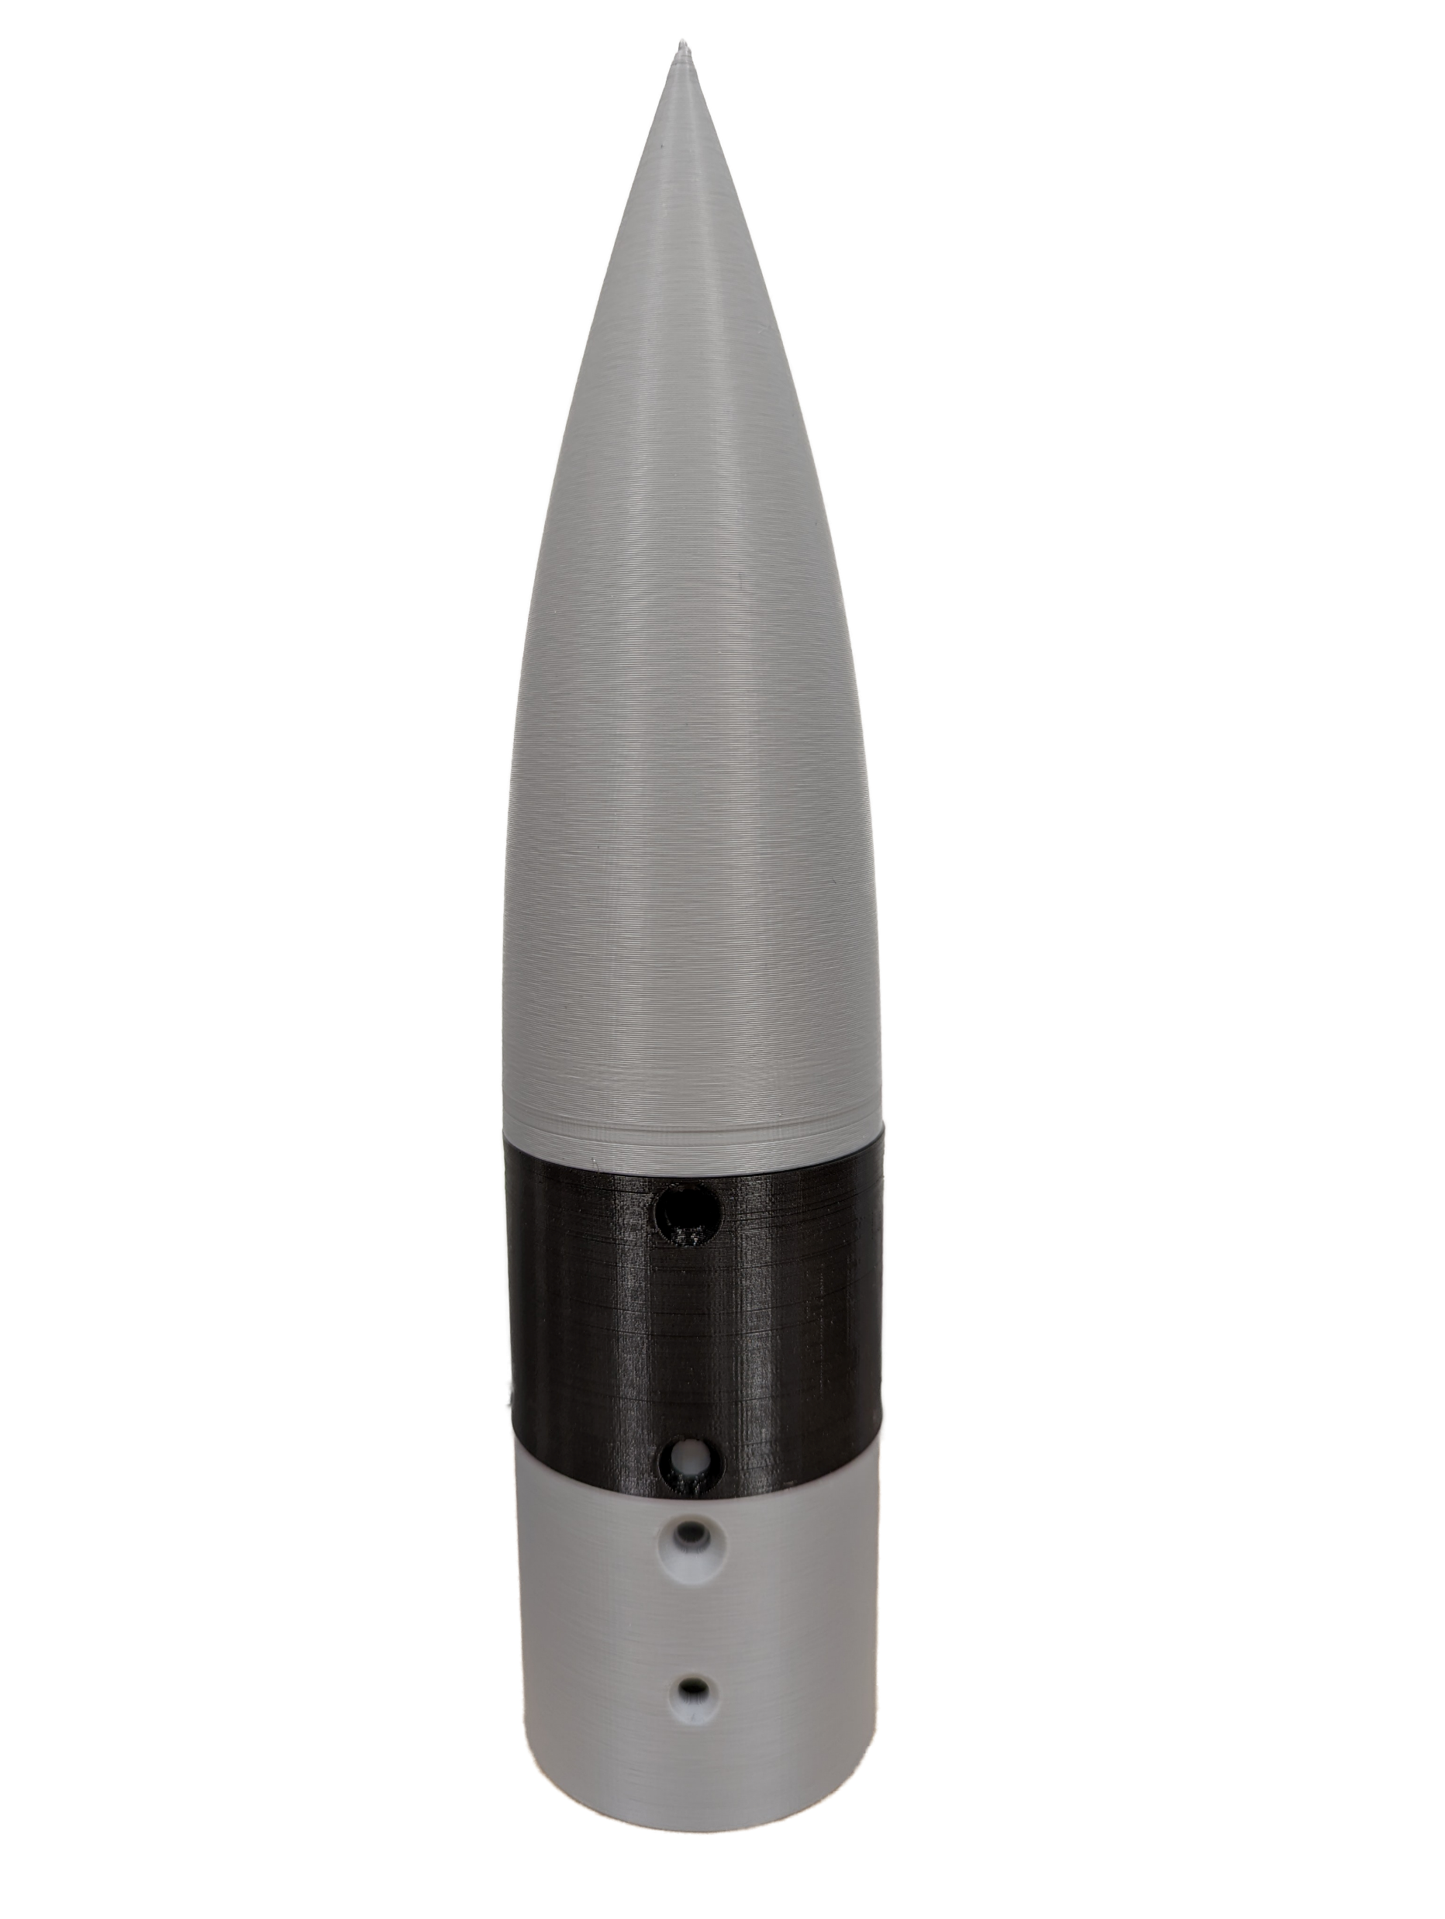
Gap Handling: 3D Printed Flex
NinjaFlex 3D Printer Filament
  Promising flex characteristics
  Will have to test multiple thicknesses
  Requires calibration and time to print
Noah Moffeit

Slide 14
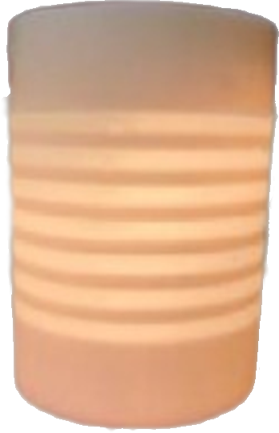
Gap Handling: Spring Sleeve
A mixed material 3d print has been designed to allow for spring-like flexibility while retaining rigidity
  Multiple sleeves in production by the Air Force Research Laboratory
  Restricted by the deflection angle
Noah Moffeit

Slide 15
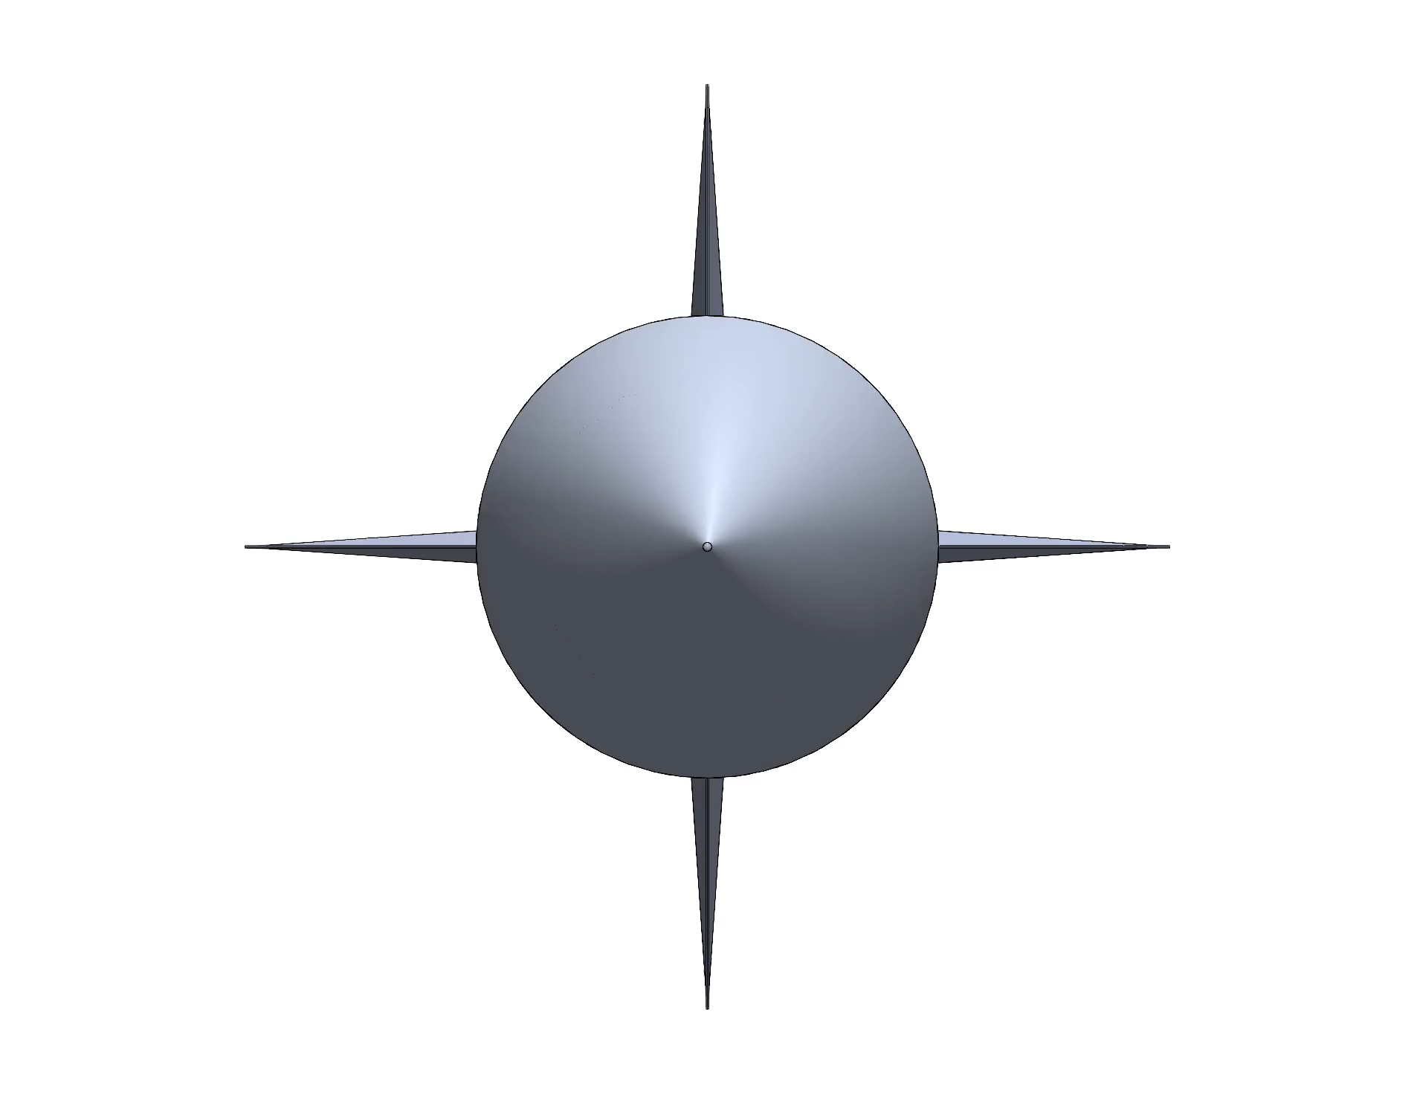
Nose Deflection Process
Operation allows for 20° of deflection
The deflection is then directed into the desired position
  Working towards rotating and deflecting in unison
Noah Moffeit

Slide 16
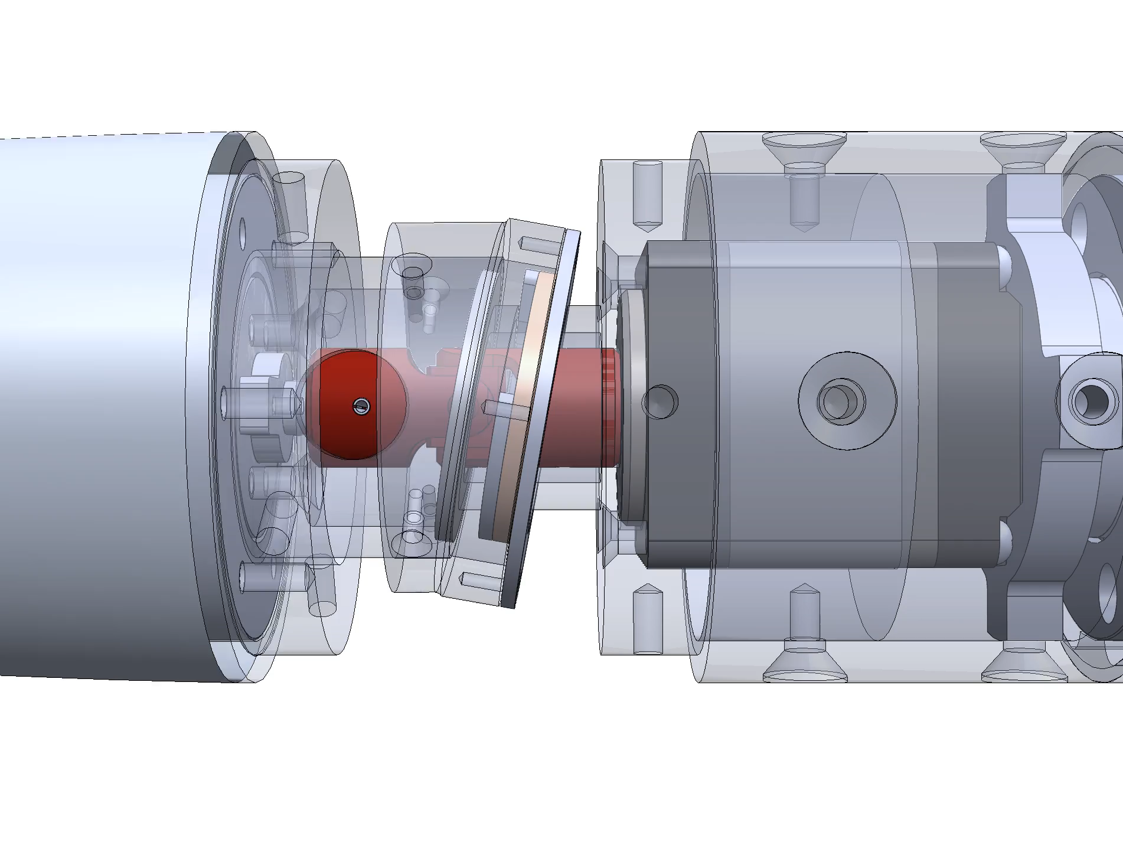
Contact Surface Operation
- Universal joint highlighted in red
  Allows for power translation
Custom collar designed to prevent axial translation
Noah Moffeit

Slide 17
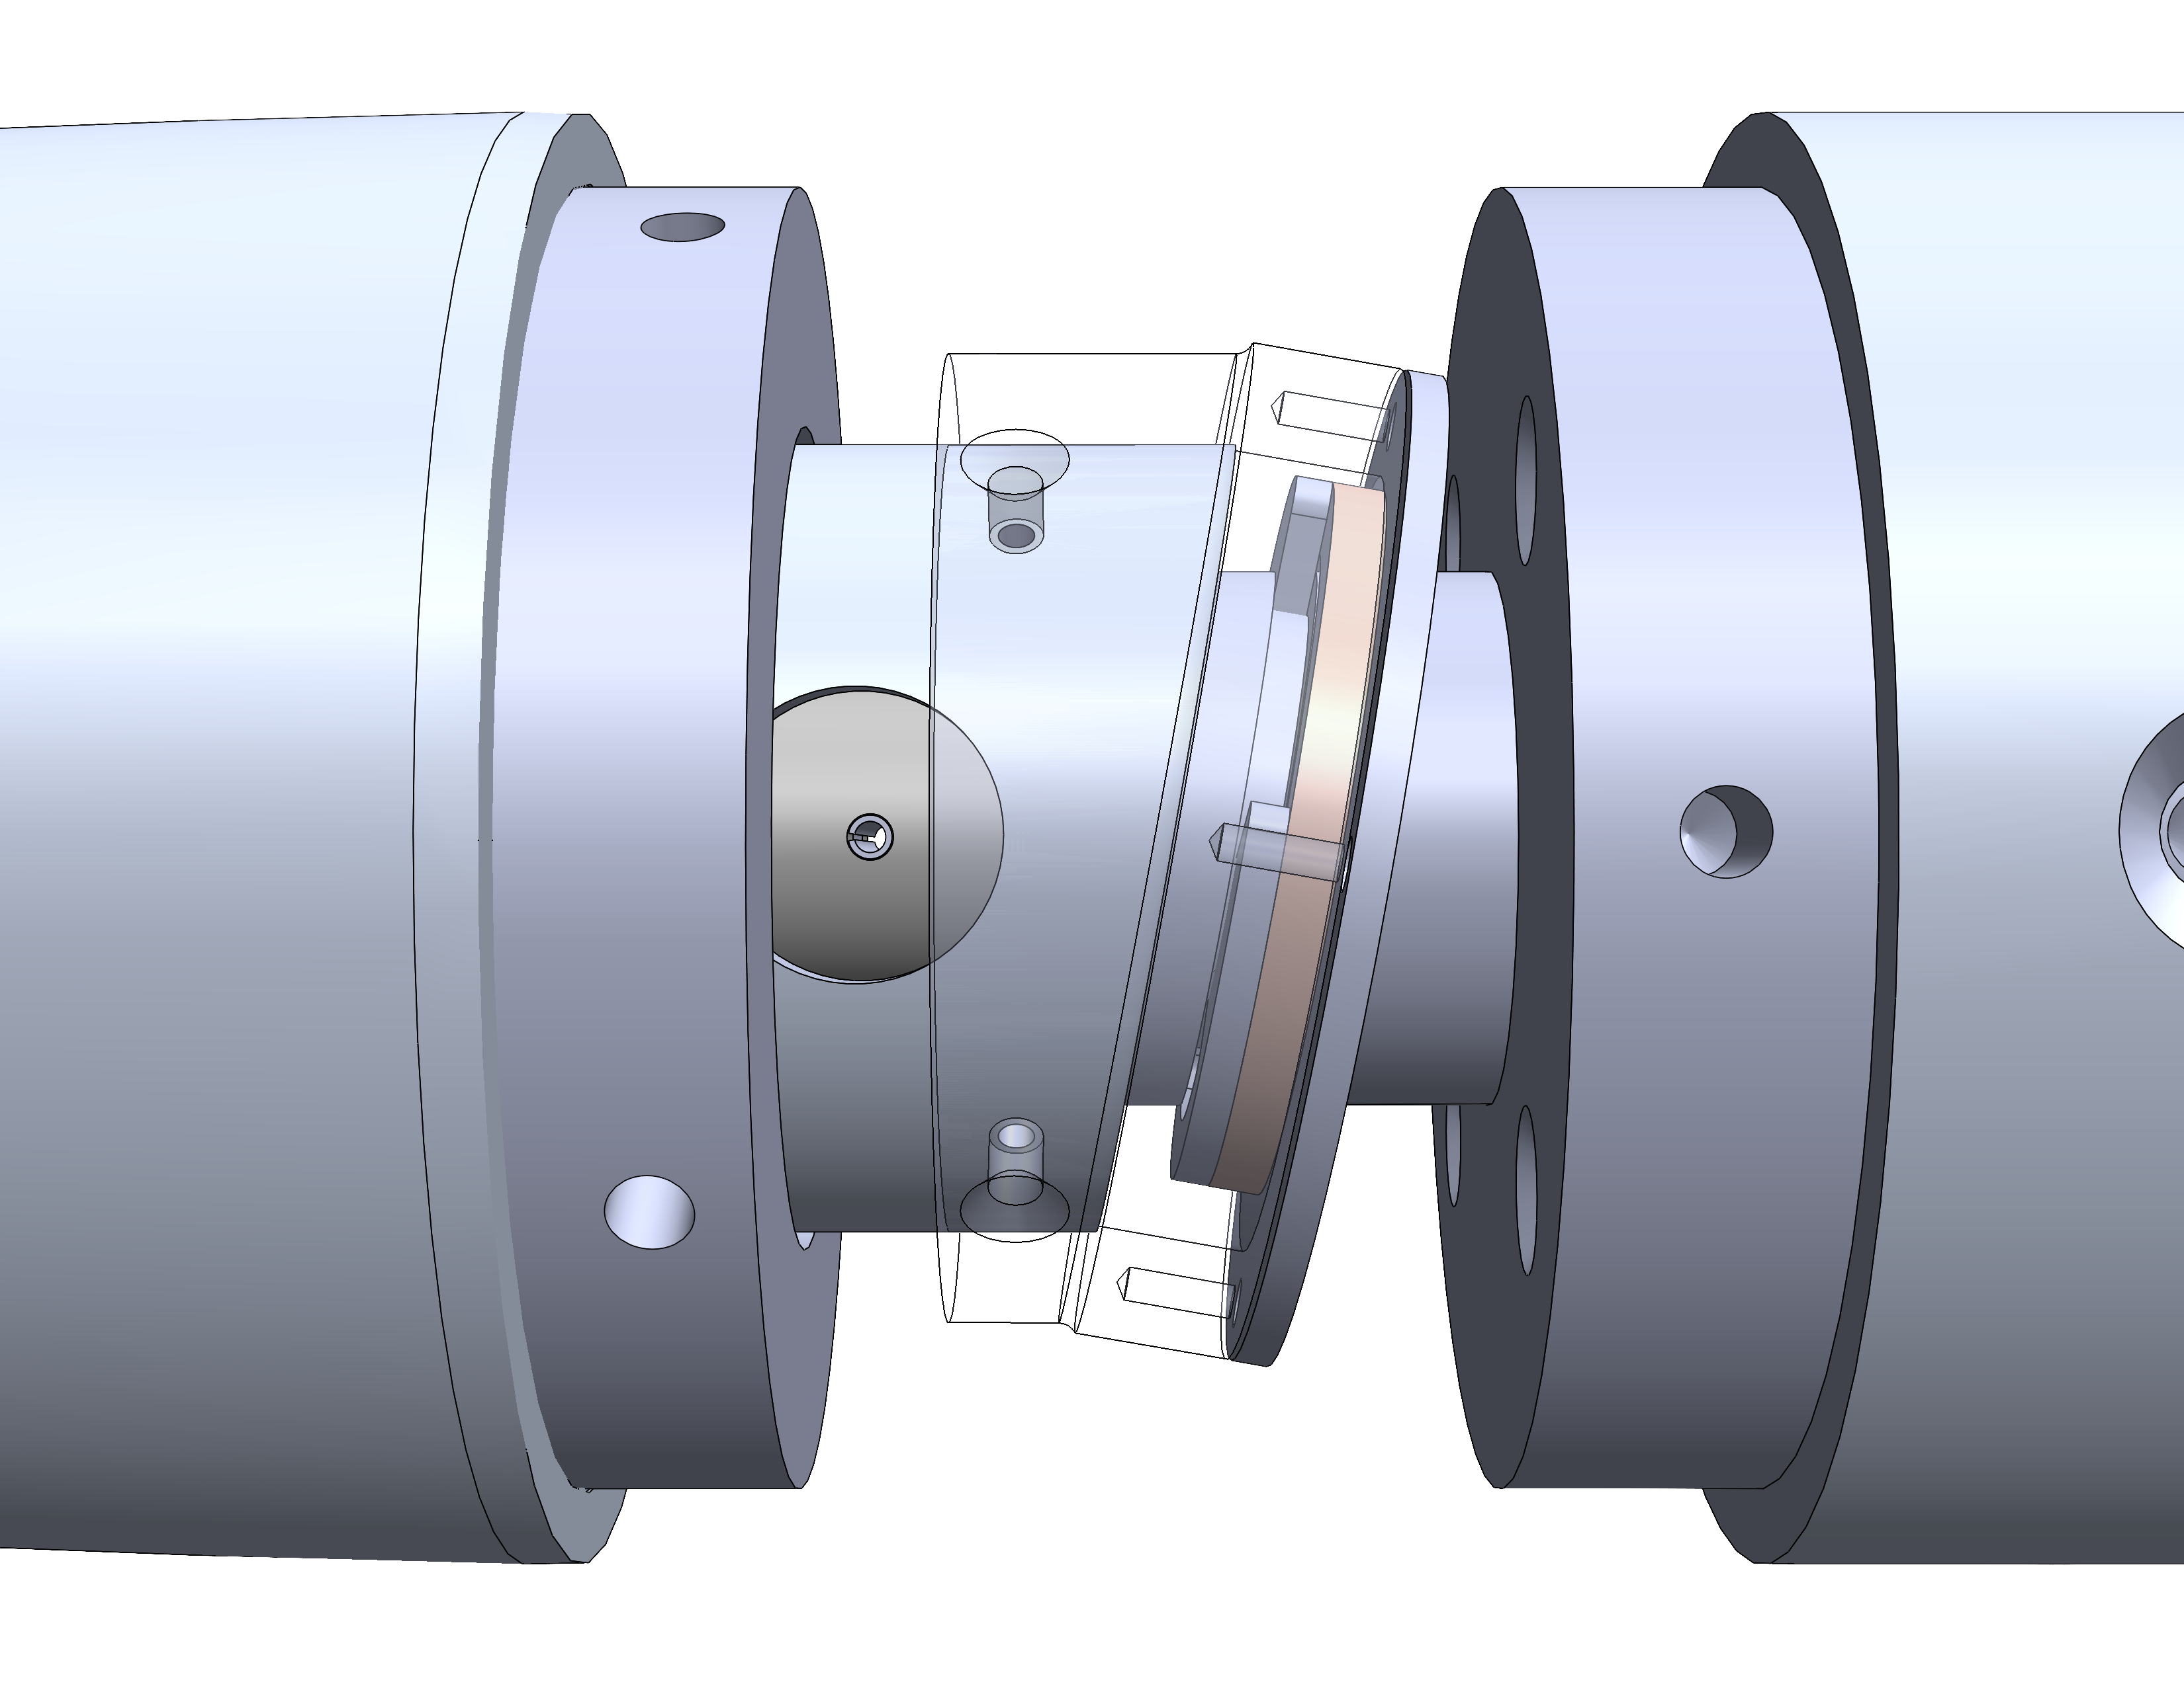
Combating Friction
Inherent friction between concentric surfaces
Solutions
  Washer and retaining clip
  Solid lubricants
  Bearings
Two face-mounted bearings used to rotate outer surfaces
Noah Moffeit

Slide 18
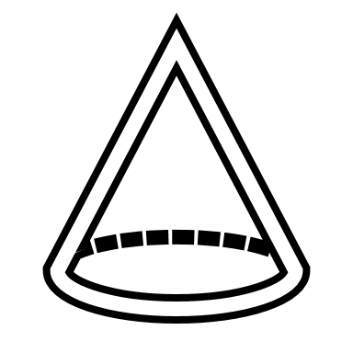

Benchtop Testing
Calibrate motor rotation
Develop code to control
Determine nose deflection for motor rotation
Noah Moffeit

Slide 19
Future Work
Make final purchases
Continue prototyping bendable sleeves
Finalize machining and test fittings
Test model within the tunnel
Noah Moffeit

Slide 20
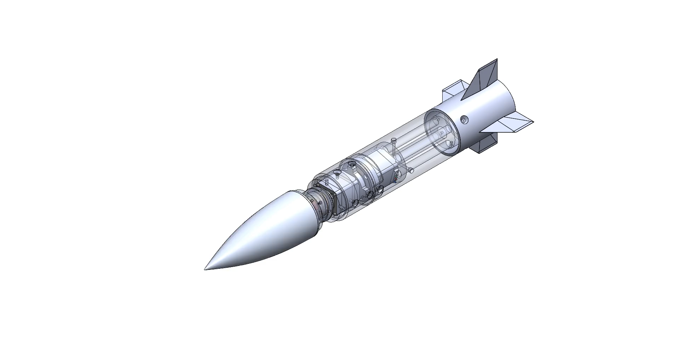
Thanks for listening
`
Jed Fazler
Robert Smith
Noah Moffeit
Nicholas
Samuda
Jed Fazler | Noah Moffeit | Nicholas Samuda | Robert Smith

Slide 21
Project Description and Key Goals
This project aims to create a technology that can be applied to many projectile configurations, allowing the projectile to maneuver adaptively through unforeseen, hazardous environments. The technology developed will detect said obstacles or conditions and actuate the projectile autonomously.
The key goals were selected to itemize the main objectives that must be accomplished over the duration of the project based on the project’s description and advice from the project’s sponsor. The following are the goals or milestones we have derived to ensure the project’s completion:
  Conceptualize and research 5 different innovative ways to maneuver a projectile.
  Choose one of these designs to expand upon and develop into a working design.
  Develop innovative technologies that can be implemented into the projectile allowing for smart capabilities.
  Develop a way for the projectile to adapt to its environment or obstacles through autonomous actions.
  Construct a scaled down model of the projectile for use in wind tunnel testing to verify desired aerodynamic characteristics of design.
  Construct a prototype projectile to test actuation of the smart functionality within the projectile.

Slide 22
Market
The primary market for this project was seen as the company or organization that the product would be directly constructed for and would use the product.
Primary Markets:
  Florida Center for Advanced Aero Propulsion (FCAAP)
The secondary markets are a makeup of other companies or organizations who may benefit from or would be interested in purchasing the results of this project.
Secondary Markets:
  Air Force Office of Scientific Research (AFOSR)
  Lockheed Martin
  Raytheon Technologies
  Northrop Grumman

Slide 23




Assumptions
Propulsion
It is assumed that:
Projectile deployment
Entailing storage
Transportation
Initial launch
will be facilitated by technologies already implemented in the projectile. It is also assumed that the projectile will remain within earth’s atmospheric conditions for its use.
Deployment
Storage

Slide 24
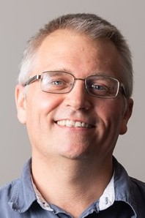
Stakeholders
The stakeholders for this project include all parties who will have influenced the design of the technologies produced by the project as well as those who have invested time and other resources into the project.
Dr. Shayne McConomy
Dr. Rajan Kumar
Dr. Jonas Gustavsson
FCAAP
FAMU-FSU College of Engineering

Slide 25
Customer Needs
How do you think current control surfaces and their actuation can be improved? | Current control surfaces require clean flow, which is not realistic at high angles of attack, so that’s something. | Projectile accommodates for attached flow over control surfaces.
What draw backs come with standard fin deflections as a control surface? | Must have clean flow to actuate properly. Size and weight that come with actuation mechanism | Projectile control surfaces will be suitable effective even in detached flow.
What Mach numbers would be expected for this projectile? | FCAAP polysonic wind tunnel can’t go faster than Mach 5. We’ll probably test Mach 4. | The projectile can withstand Mach 4.
What slenderness ratio of the projectile would be appropriate? | Would be nice if it could be tied into what we have done already. Matching a baseline design here at FCAAP. 8-10 | The projectile uses a basic axisymmetric body configuration based on previously tested models.

Slide 26
Customer Needs
Do we need to worry about designing the method of propulsion? | Don’t worry about designing the propulsion as we cannot have it modeled in the wind tunnel. | Propulsion is beyond the scope of this project.
By the end of this project, what level of manufacturing should be accomplished to demonstrate our results? | Small model for testing control surfaces in wind tunnel, larger model for demonstration purposes and sensing capabilities. Radar sensors possible option. | The projectile is modelled for aerodynamic testing and then prototyped for proof of actuation.
What conditions do you expect the projectile to operate in? | Projectile should go where the target goes. High angles of attack. Initial deployment shockwaves and vortices. Vibrations in supersonic can affect and disrupt the electronics. | The projectile has a way to rapidly adapt to the conditions that exist during deployment.
Should the projectile be able to actuate without user input? | Yes | The projectile is automatically operated.

Slide 27
Customer Needs
Should favorable aerodynamic characteristics be prioritized over functionality? | No, it should accomplish the task while minimizing negative effects. Compare to previous results. | Maintaining aerodynamic characteristics is secondary to maintaining control surface effectiveness.
What is considered a “harsh” or “hazardous” | Vortices, and shockwaves off the parent aircraft. High angles of attack | The missile adapts to high pitch angles.
What will be the preferred method of flow visualization? | It looks good. Better for showing actuation effects. Could be done with shadow graph in the wind tunnel. Not necessary but helpful. | Flow visualization will be done through other tests such as shadowgraph or oil flow.
Will the projectile also have to accommodate targeting? | Does not necessarily need to sense targets, could also sense high angles of attack. | The missile can sense its angle of attack in various scenarios.

Slide 28
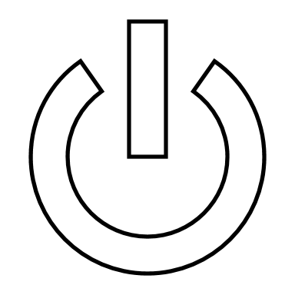

Functional Decomposition
Storage
Provides power for components
POWER
Transmission
Transfers power to components
Jed Fazler

Slide 29

Functional Decomposition
Sensors
Monitors sensor data
SENSING
Interprets sensor data
Signaling
Transmits response signal
Jed Fazler

Slide 30
Functional Decomposition
Flow
Maintains flow attachment
Controls pitch
ACTUATION
Mechanical
Controls roll
Controls yaw
Jed Fazler

Slide 31
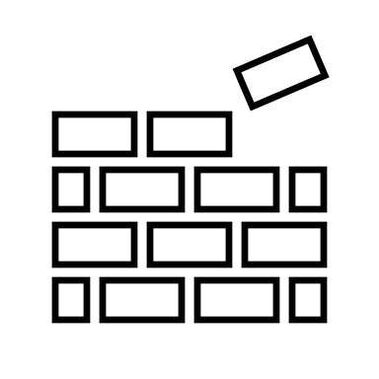
Functional Decomposition
Maintains integrity
STRUCTURE
Protects components
Jed Fazler

Slide 32
Jed Fazler
Noah Moffeit
Robert Smith
Nicholas
Samuda

Slide 33
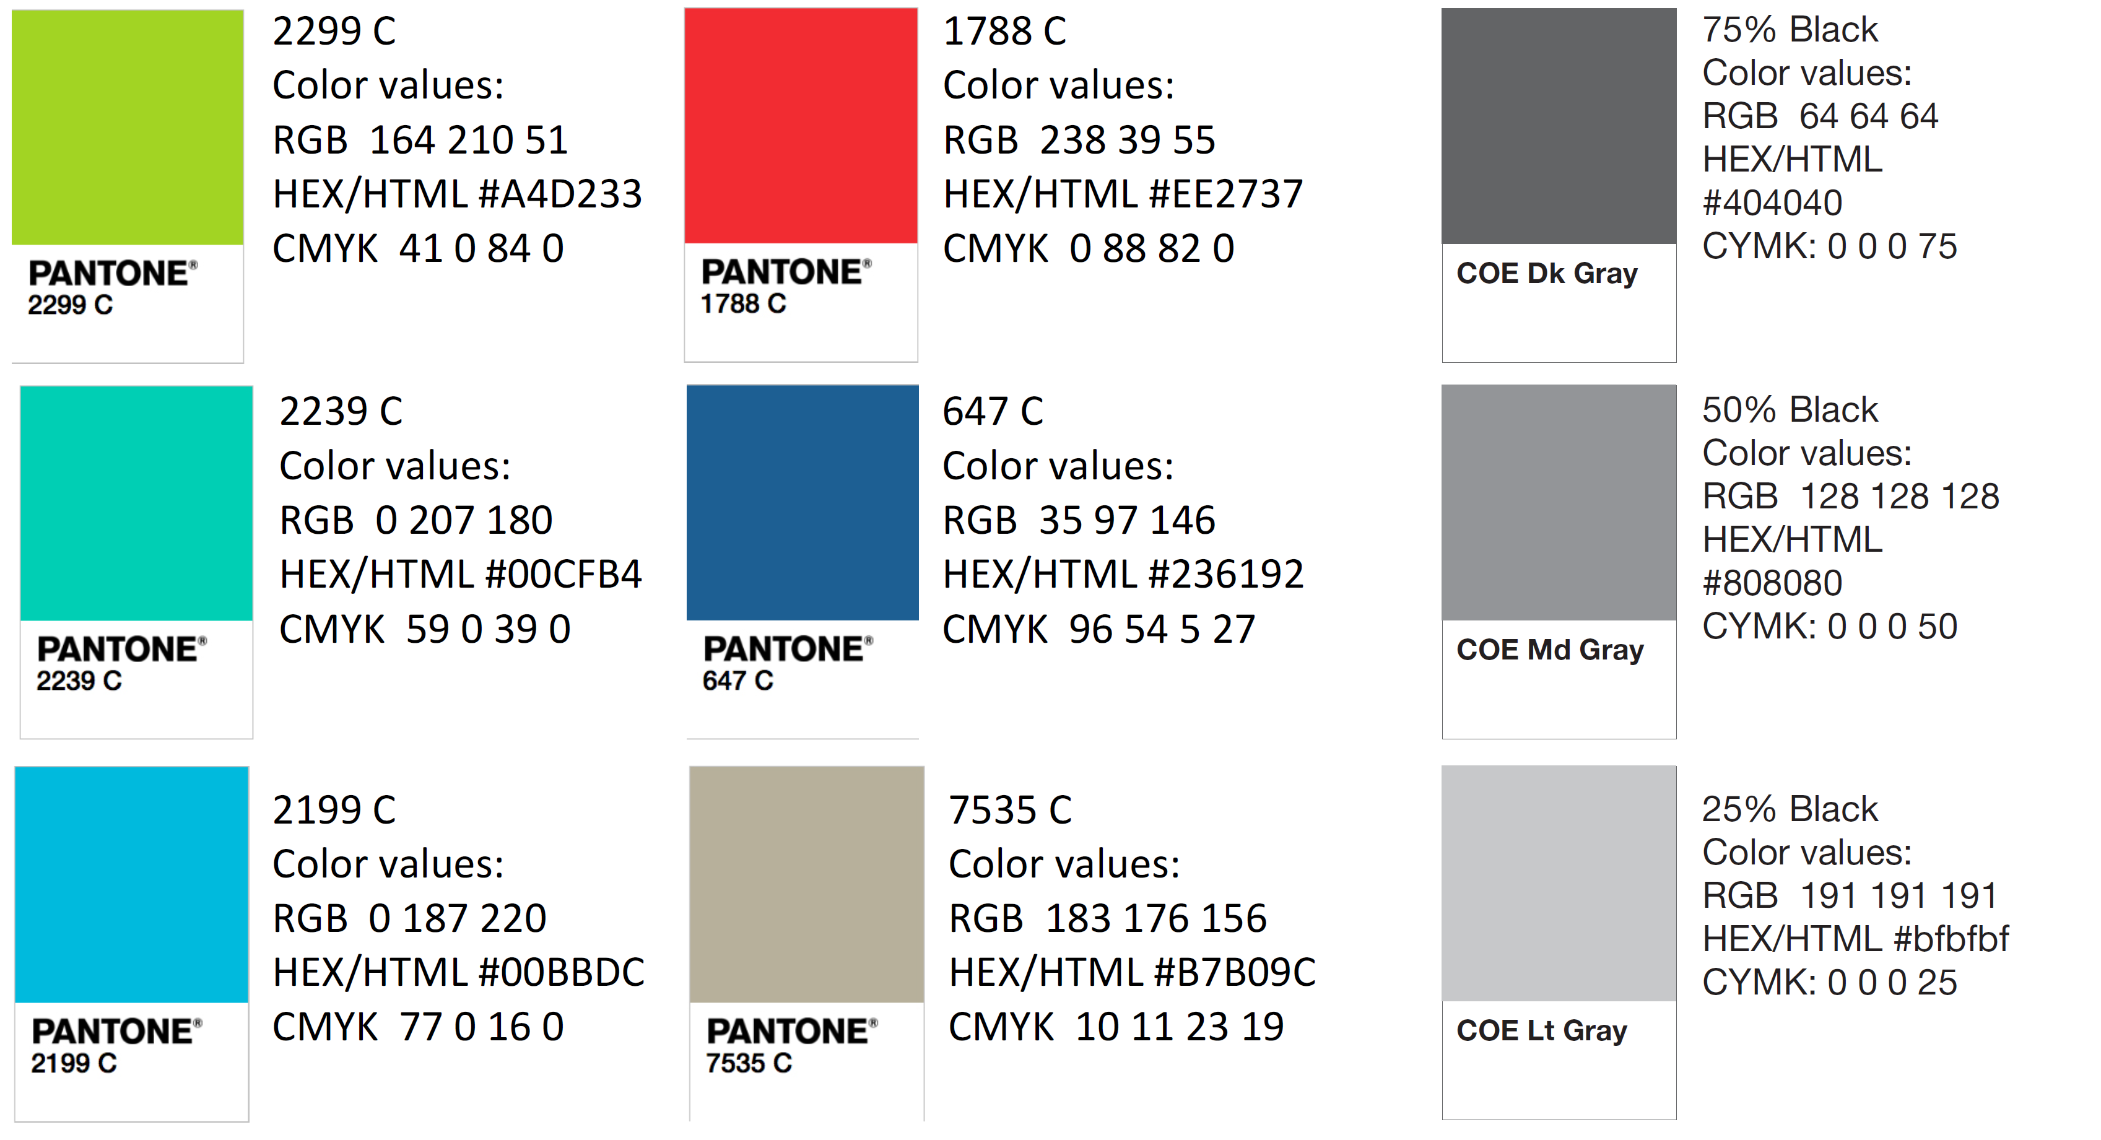
Color Palette
How do you think current control surfaces and their actuation can be improved? | Current control surfaces require clean flow, which is not realistic at high angles of attack, so that’s something. | Projectile accommodates for attached flow over control surfaces.
What draw backs come with standard fin deflections as a control surface? | Must have clean flow to actuate properly. Size and weight that come with actuation mechanism | Projectile control surfaces will be suitable effective even in detached flow.
What Mach numbers would be expected for this projectile? | FCAAP polysonic wind tunnel can’t go faster than Mach 5. We’ll probably test Mach 4. | The projectile can withstand Mach 4.
What slenderness ratio of the projectile would be appropriate? | Would be nice if it could be tied into what we have done already. Matching a baseline design here at FCAAP. 8-10 | The projectile uses a basic axisymmetric body configuration based on previously tested models.

Slide 34
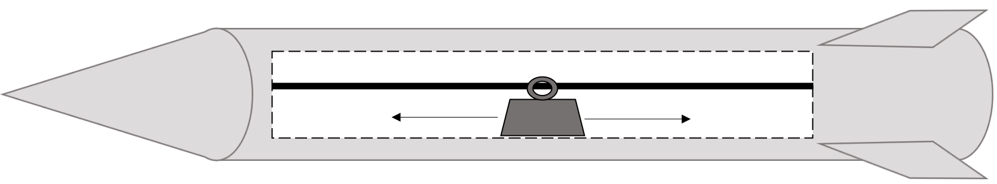
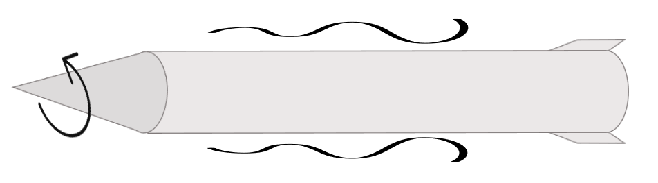
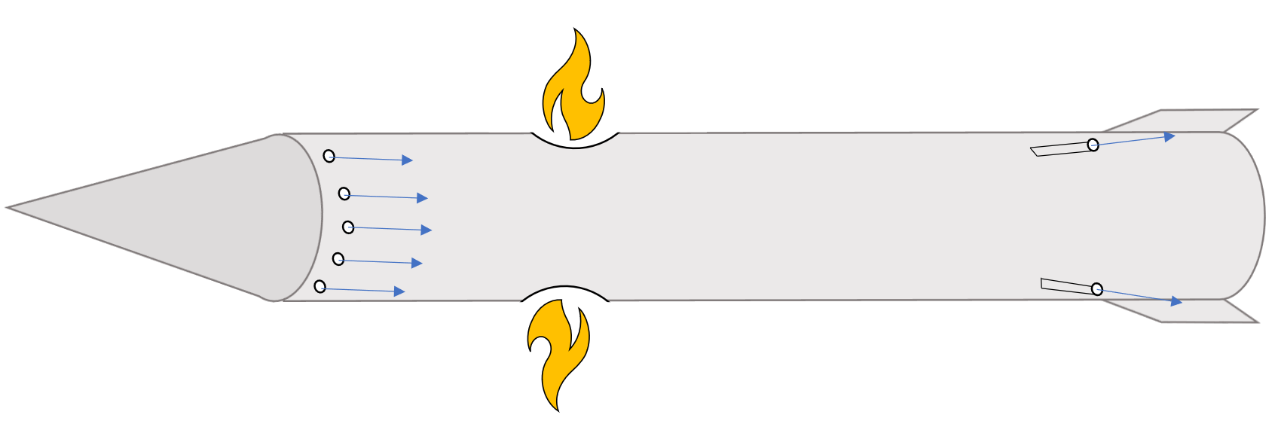
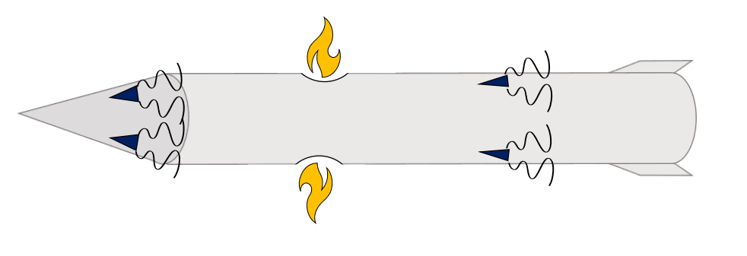
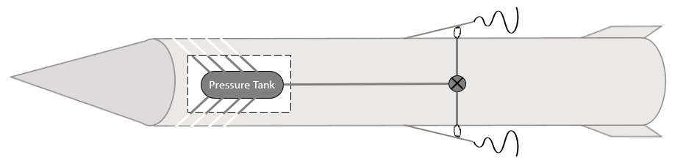

Slide 35
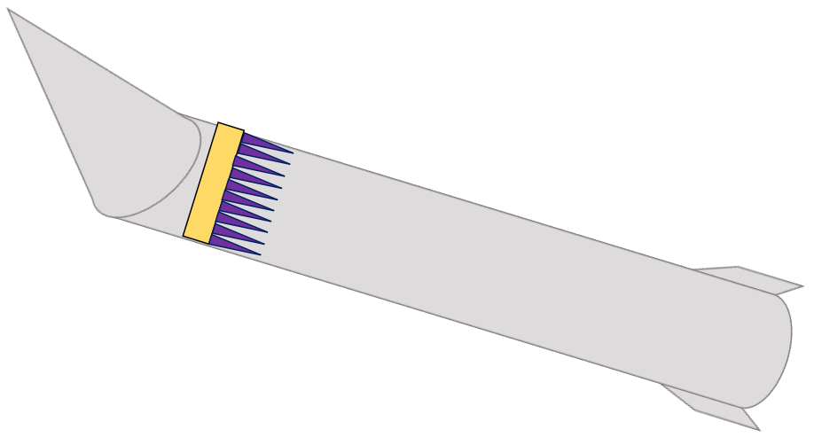
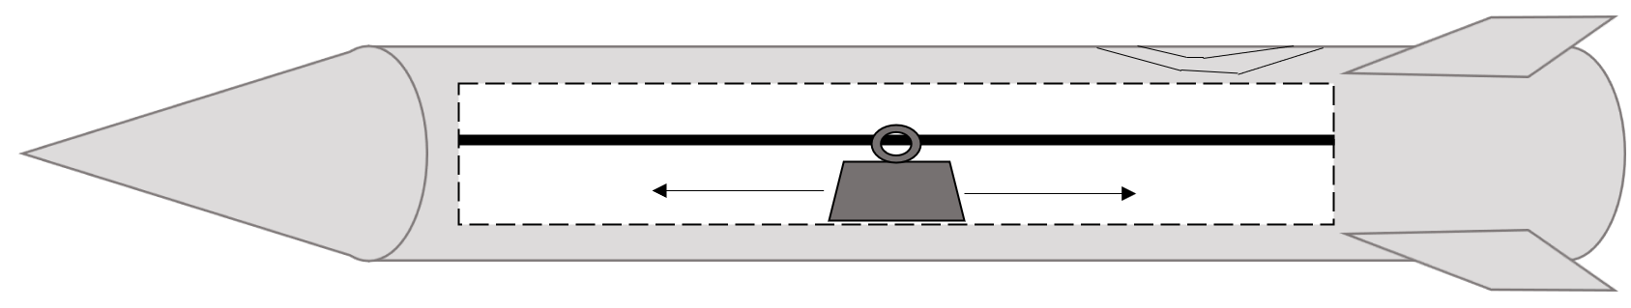
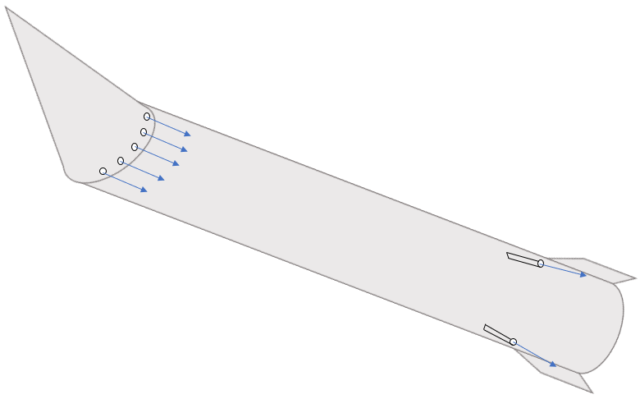

Slide 37


Slide 38
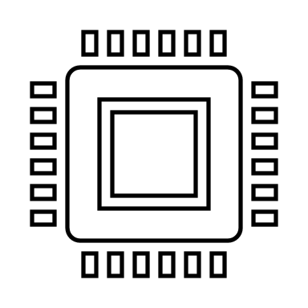
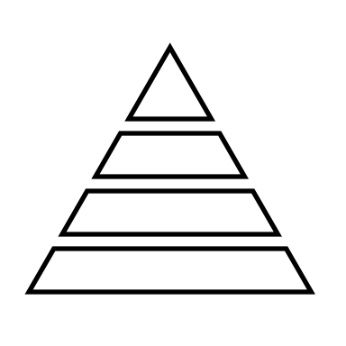
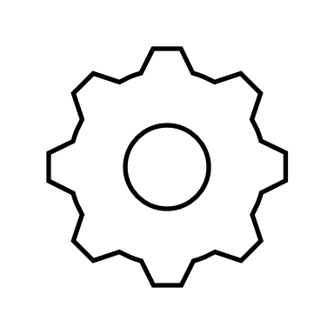

Slide 39
Nose Pulleys
Linear Actuators
Rotating Contact Surfaces
2 DOF Gear Box
Polar Controller
Basic Rotating Nose
Robert Smith

